Slide 1

Growing by Customer Segmentation
Notes:
Hello, I’m Fawwaz and I am part of the Cyan data team. Today I will be talking about how we can grow prism using customer segmentation

Slide 2


Key Objectives
- Improve customer conversion rate
- Improve customer retention
- Identifying key/important customers
Notes:
Growth, ultimately referring to increasing our revenue and profit which will allow us to expand further on a global scale
Aim to achieve this by…
Conversion – of emails through personalised targeting using our segments
Improve retention by building better relationships with out customers with emails
And off course, identifying our best customers and key groups of customers which we would like to take full advantage of but also keep happy

Slide 3

Our Current Numbers
Customer Retention decreased from 29% to 23% between 2021 and 2022
Prism’s cart abandonment rate is significantly higher than the average of 57.9% as reported by freshrelevance
https://www.freshrelevance.com/resources/real-time-marketing-report-may-2022/
Notes:
We have 4 primary KPI’s which we measured our segments against. Overall cart abandonment has been the most consistent over the years, but is relatively high to the industry average. This is something we would definitely like to improve upon. Conversion rate and customer retention fell YoY whilst the Average Spend per customer grew by almost 50%. So why can we gain from marketing to our registered members
Cart abandonment is significant! Highlight it.

Slide 4

Registered members are IMPORTANT!
Notes:
- Looking at the revenue split between members and non-member shoppers
68% of all revenue from members

Slide 5
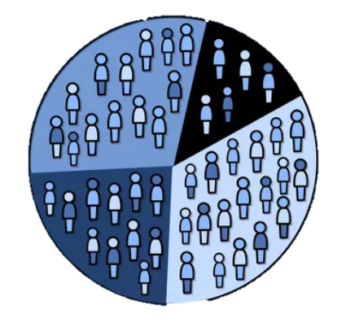
Explored Segments
Demographic – Age, City did not produce anything significant against KPI's, we require more data.
RFM – Identified key member groups using RFM score.
Behavioural – Time of Day, Members in Loyalty programmes

Slide 6
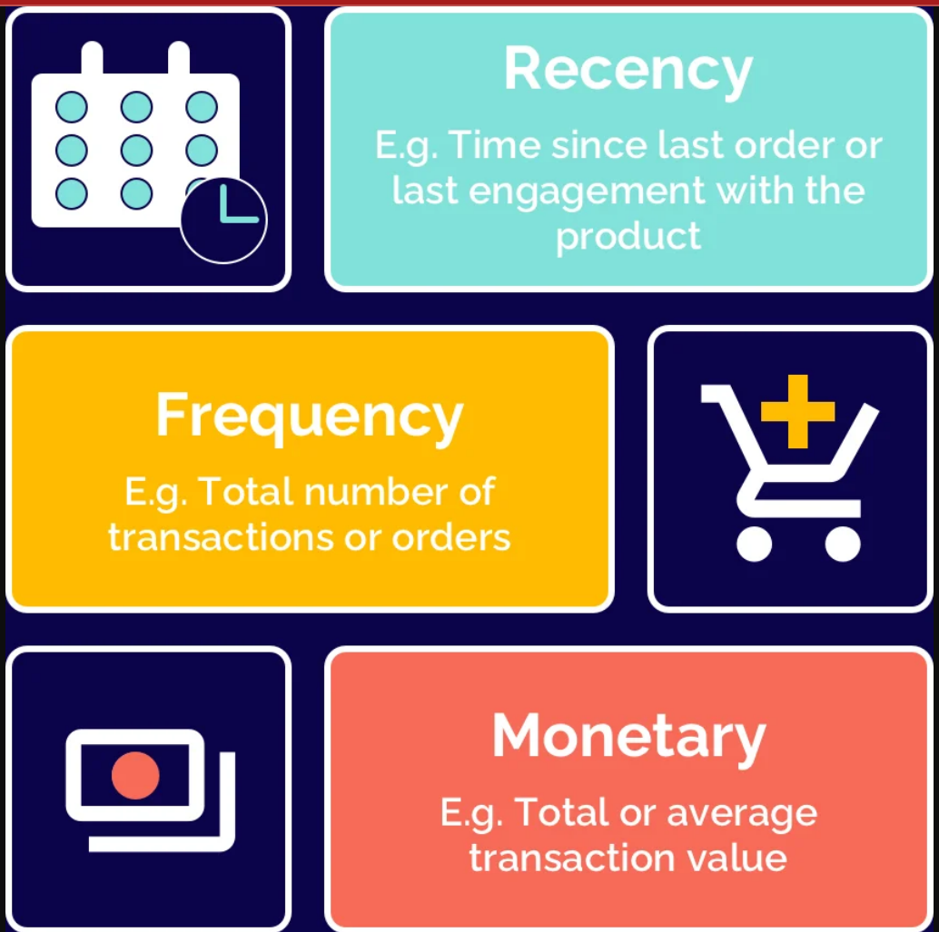
RFM Segment Breakdown
Best Customers
- Most Recent
- Most Frequent
- Highest Monetary
Most Loyal Customers
- Most Frequent
Low Spending Loyal Customers
- Most Frequent
- Lowest Monetary
Whales, Highest spending customers
- Highest Monetary

Slide 7
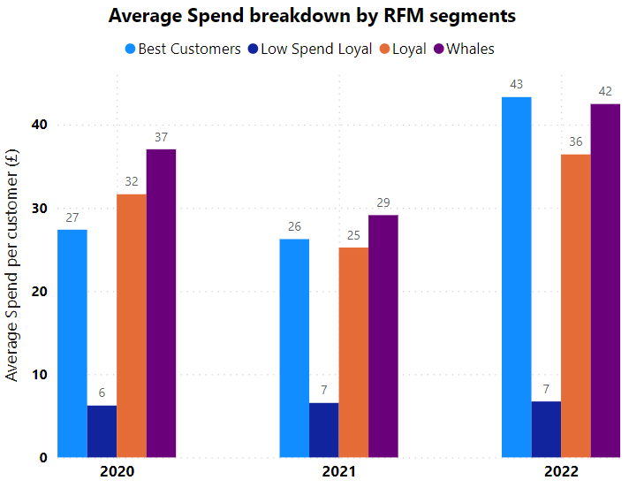
RFM Analysis
Cart Abandonment Rate is under 50% for all RFM segments
Best Average Spend for Best Customer and Whale segments

Slide 8
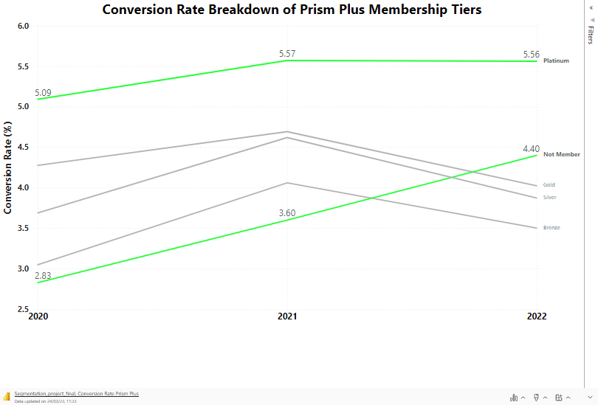
Platinum Customers
- Platinum Prism Plus customers have the highest conversion rate
- Platinum customers account for only 8.6% of prism plus members
- Significant no. customers not part of Prism Plus
Notes:
On this graph you can see the conversion rates for the different tiers within Prism plus. The conversion rates are higher than the overall conversion rate for prism because only customers were included in the calculations, people who were on the website but not customers are not included.
Platinum customers have the highest conversion rate and are therefore most likely to proceed to purchase. They are the customers that would be most useful to target.
Platinum customers account for only 8.6% of prism plus members so targeting them alone will not improve sales drastically. It is important to try to increase platinum prism plus members to capitalise on their conversion rate, however, there are also a significant number of customers who are not part of the scheme. It would be valuable to encourage them to join Prism Plus which would hopefully lead to an increase in conversion rate in line with the numbers we are already seeing.
On average, non-members spend the most at prism. Targeting these members would allow us to capitalise on their higher spending. Although the difference in average is small, there are far more non-members than prism plus members.
It is interesting to note that there were no new prism plus members added in 2022, following on from a decline in 2021. We have seen that conversion rates are high amongst members so by not increasing their number we are losing out on valuable sales. We need to encourage customers to sign up for Prism Plus to increase the number of people who will likely have a high conversion rate.

Slide 9
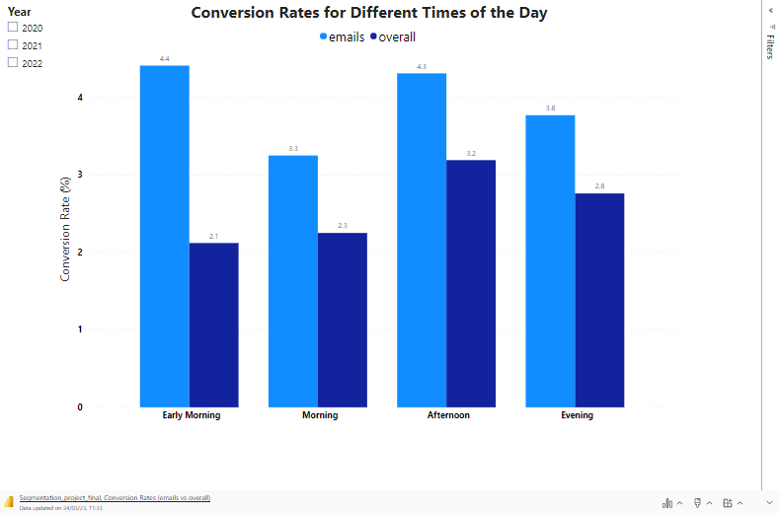
Time of Day Segmentation
Early Morning = 0001 – 0600
Morning = 0601 – 1200
Afternoon = 1201 – 1800
Evening = 1801 – 0000
- Conversion rate highest in Early Morning and Afternoon
- Can increase customer engagement with timed email release
Notes:
We thought it would be interesting to look at what time of the day most purchases are made. As you can see from the graph, quarter 3, from 1200 until 1800, has the highest conversion rate. It is followed by quarter 4, from 1801-0000.
So as to take advantage of this higher conversion rate and web traffic, I would suggest having targeted email send times. In the email we were sent, the initial plan for customer engagement was to start emailing. If we send emails at some time during quarter 3, we are more likely to reach our customers that have a higher conversion rate as they would be online anyway. Hopefully we would see an increase in clicks and sales.
Following on from this, when we looked at the conversion rate based on the way in which people accessed the site, there were three email companies within the top 10, including first and second. Again, we can see the opportunities within email. People are already using the emails we are sending to make purchases. If we target them at the correct time of day, we can increase this further.
The average annual spend was highest in quarter 4, between 1800 and 0000, followed by quarter 3. This links with what we know about conversion rates being higher at those times of day.
Each quarter performed better in 2022 than in previous years which is a positive step that we should try to build upon.
3m – 4m
Key point
Provide an overview of the session
Opening phrase
These are the main things we’ll be focusing on in today’s session. We’re going to start with a bit of speed networking so you can find out more about your fellow trainees. Then I’m going to provide you with an overview of the course…
Delivery method
Read and adapt opening phrase as needed
Read each bullet point on the slide and elaborate as needed.

Slide 10
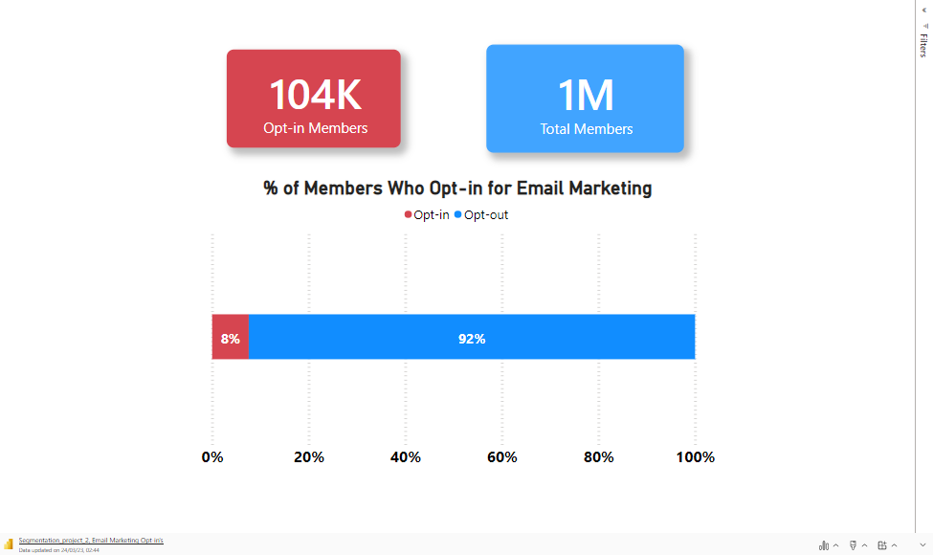
We need more Opt-ins
Notes:
Increase opt ins:
Opt-ins only account for 8% of registered
Limited in Marketing due to reach
Must increase this to have an impact

Slide 11
What can we do?
Increase opt ins (and potentially registrations) to email marketing by offering free delivery on checkout with a sign up.
Increase Prism Plus memberships by natively promoting it in emails and providing better incentives (25%+ on next order on sign up)
Encourage advancement through Prism Plus tiers through a bonus point scheme
Deliver email campaigns in afternoons to maximise probability of conversion.
Notes:
Increase Prism Plus memberships:
Significant no. customers not part of Prism Plus
No new Prism Plus members in 2022
Area for development

Slide 12
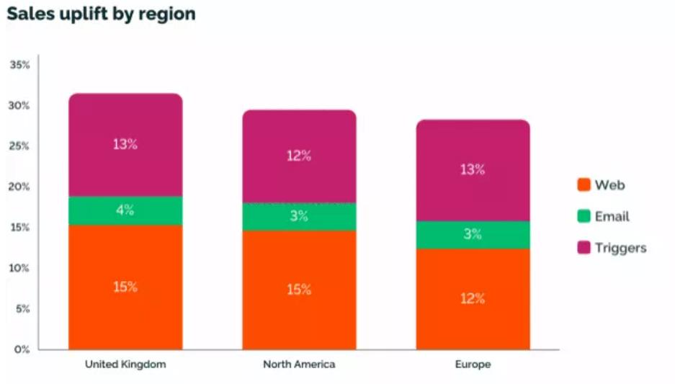
Future Actions
Further Data:
Demographics
Age, Education, Occupation, Marital Status, Family size etc.
Web Analytics
Funnel data, search data,
payment types
Product Attributes
size, colour, material etc.
Ultra Targeted Email Marketing:
Tailored email marketing specific to customers behavioural and purchase history using machine learning and AI.
Web Personalisation:
Personalised web pages with dynamic content, tailored recommendations and exclusive offers using customer segments
https://www.freshrelevance.com/resources/real-time-marketing-report-may-2022/
Notes:
- In future we could Add further data to create more segments, demographics allowing us to better relate customer characteristics with shopping habits. Web analytics giving us more information on customer behaviour and the user journey and product attributes allowing us to narrow down on what is leading customers to buy a product.
- Use AI software to ultra target out customers based on their behaviour and preferences
- Finally look into web analytics and personalisation of our web and mobile apps. fresh relevance reported that uplift was 15% on average in 2022 for personalised web marketing which leads.

Slide 13
Thank you
Questions?
Notes:
Thank you for listening, if you have any question we would be happy to answer them

